Slide 1

Memorable Moments
Lets recollect our childhood memories
PRIZE --- Voucher of RS 1000

Slide 2
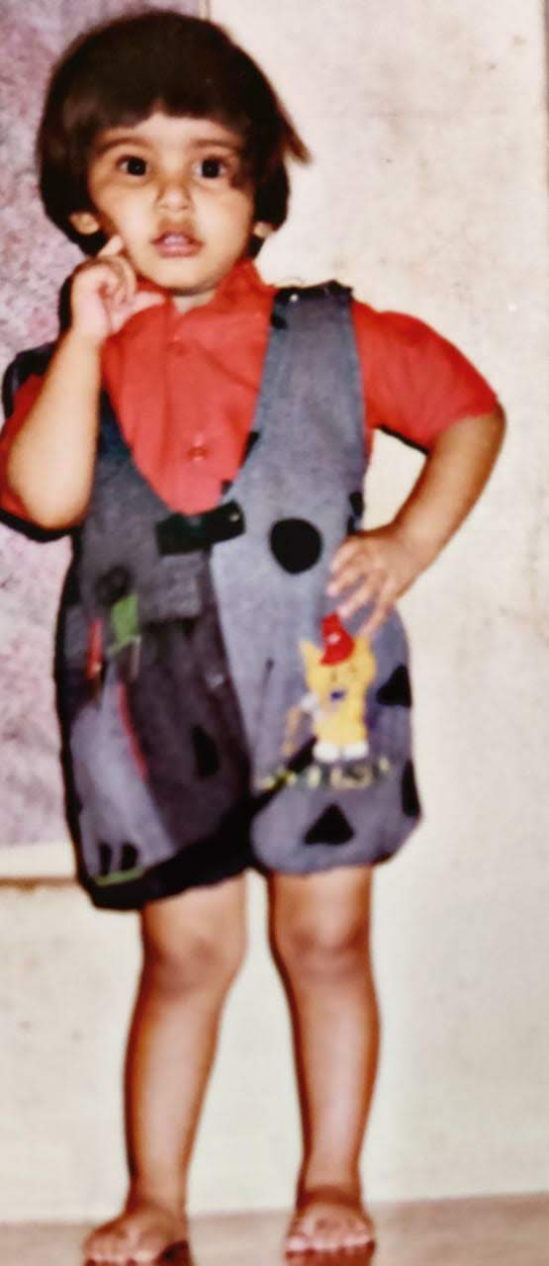
Chubby Cheeks …teeth with.. curly hair…very fair… eyes are blue lovely too

Slide 3
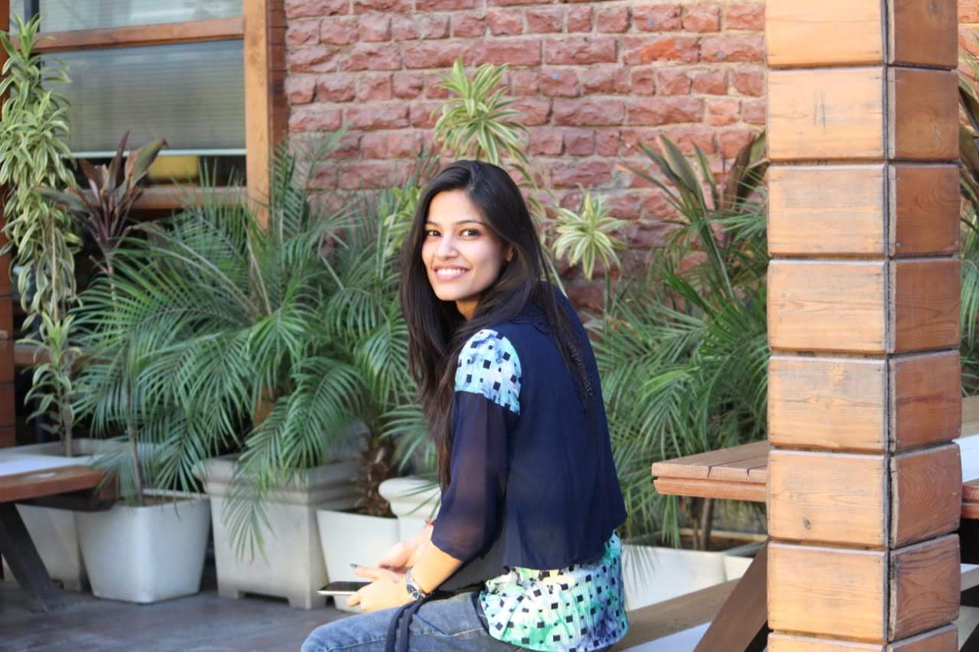
Then
Now

Slide 4
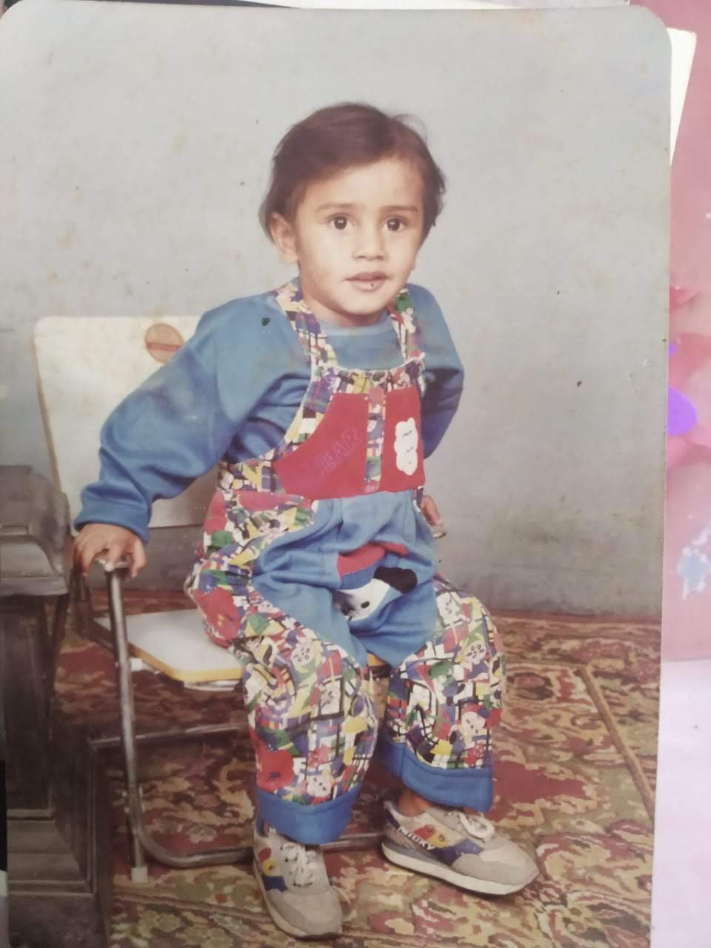
Memories of childhood were the dreams that stayed with you after you woke.

Slide 5

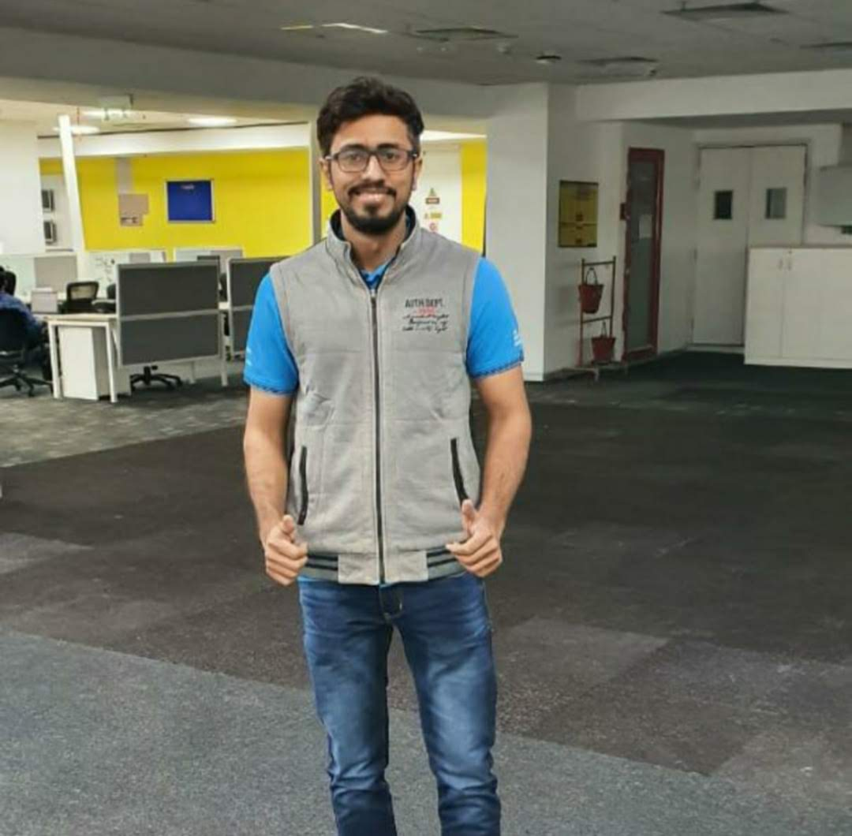
Then
Now

Slide 6
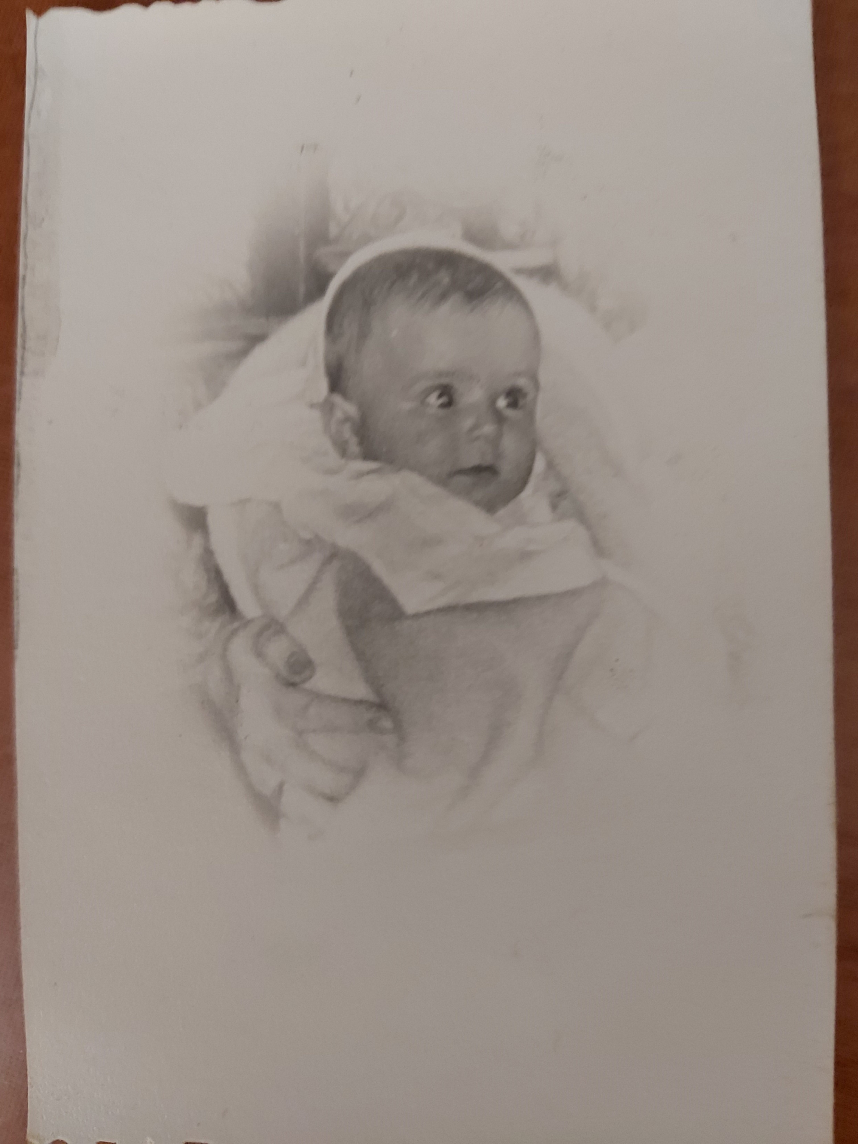
One of the Rare Pics

Slide 7

Then
Now

Slide 8
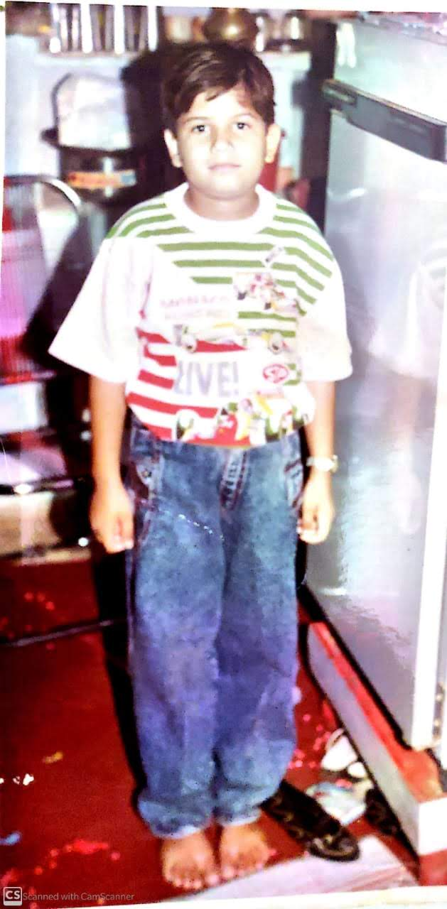
My childhood is a part of my story, and it’s why I’m who I am today and why my career is what it is

Slide 9
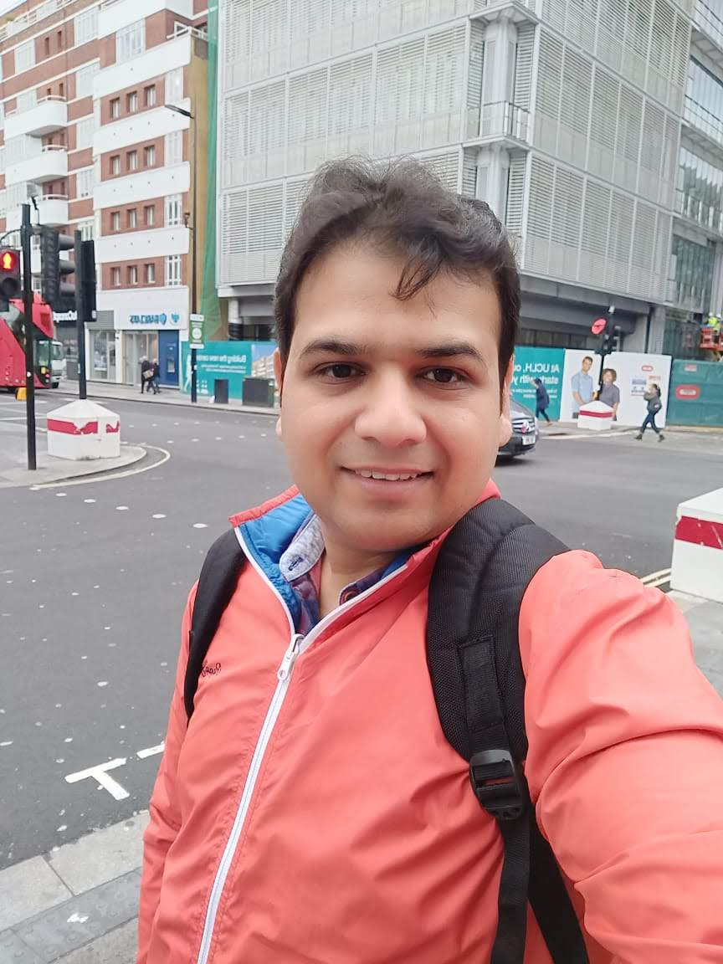
Then
Now

Slide 10
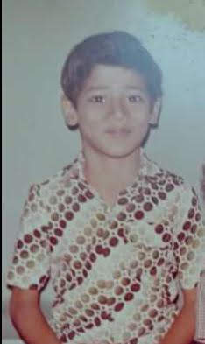
I clearly remember that day, when we were still so young, when everything was still alright.

Slide 11
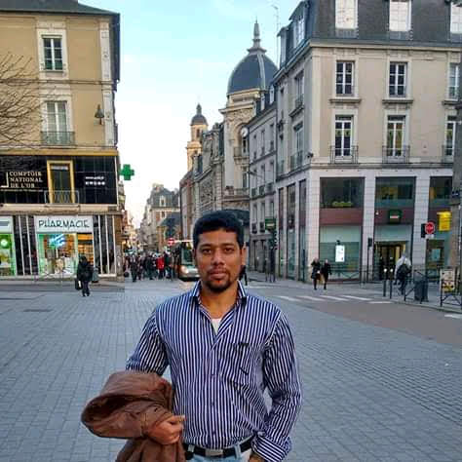
Then
Now

Slide 12
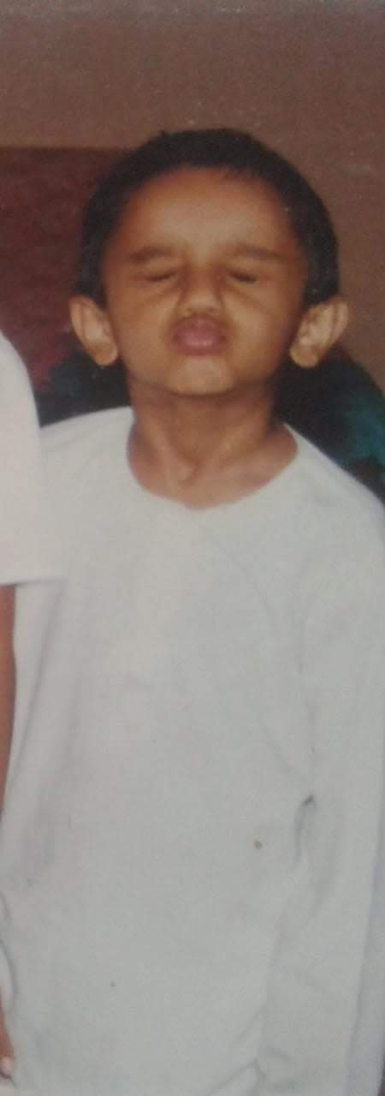
If you don’t do anything stupid when you’re young, you won’t remember something funny when your old.

Slide 13
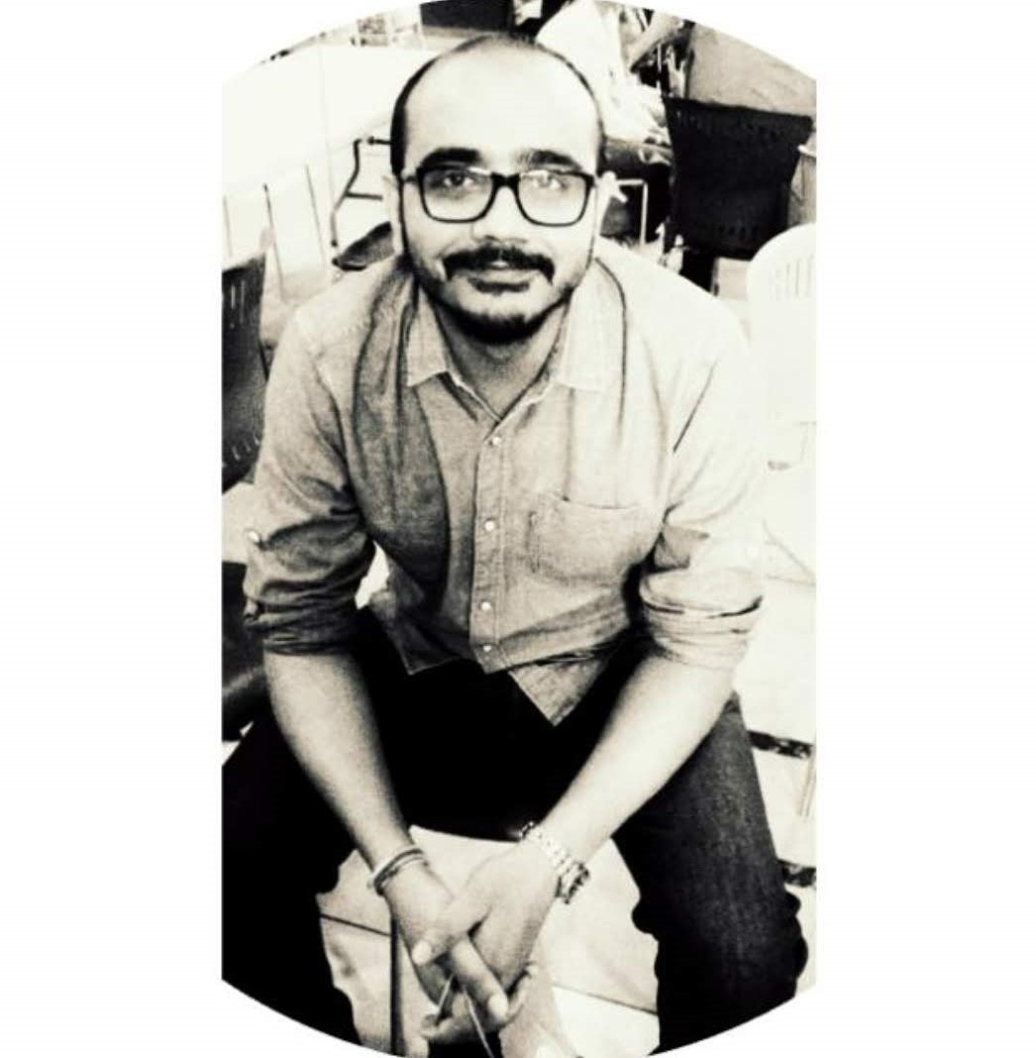
Then
Now

Slide 14
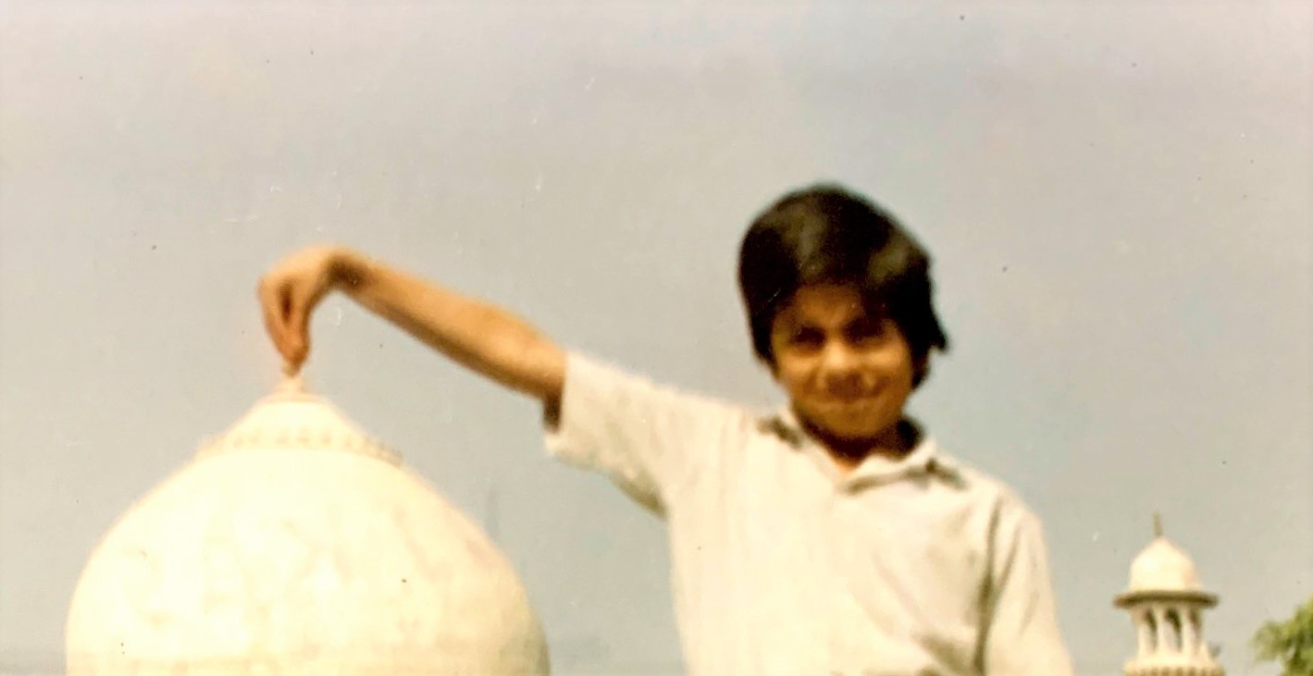
“There is always one moment in childhood when the door opens and lets the future in. “

Slide 15
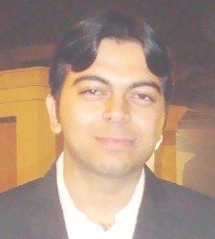
Then
Now

Slide 16
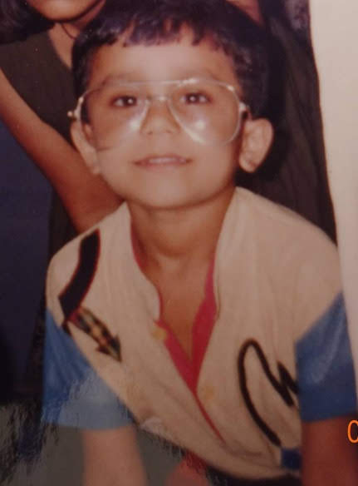
I miss being a little kid with no stress, worries or care in the world

Slide 17
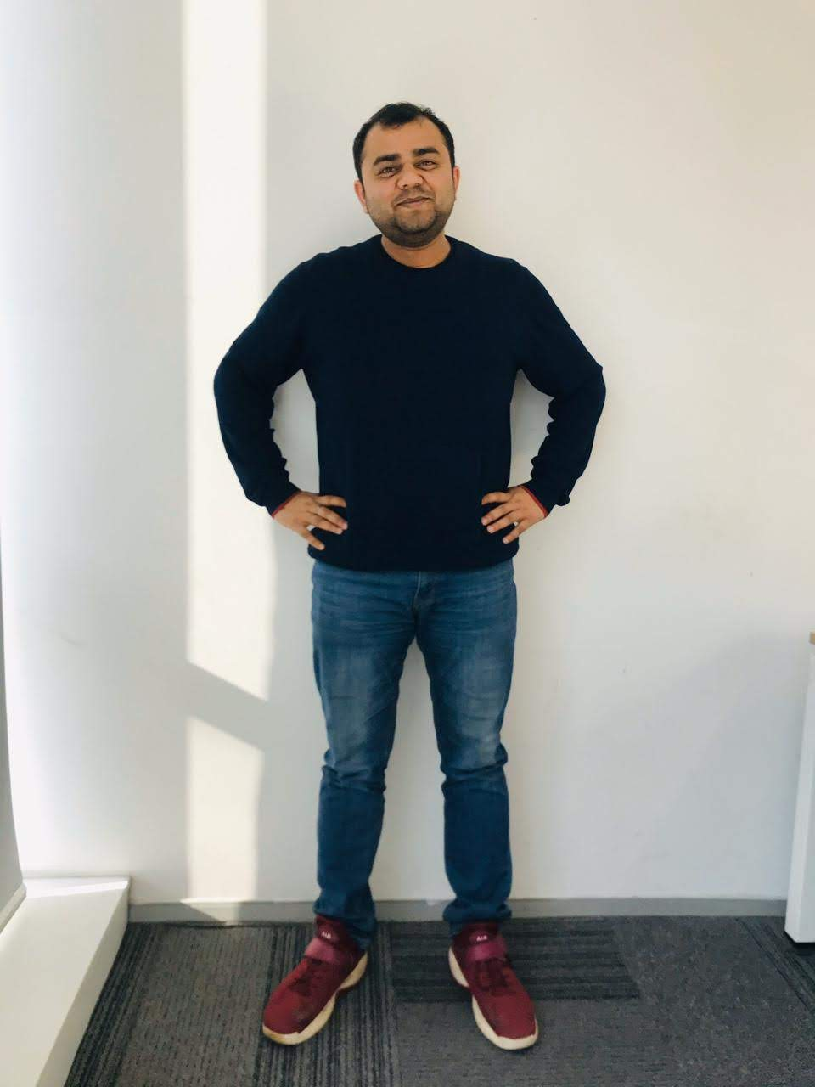
Then
Now

Slide 18
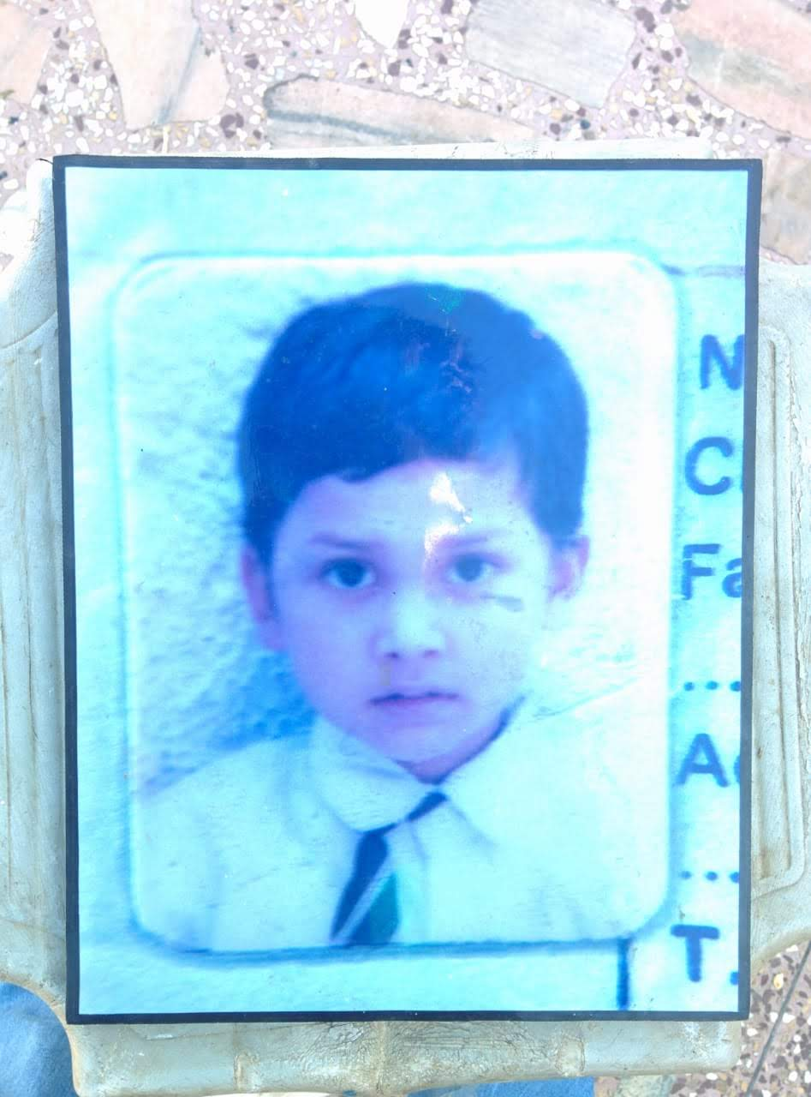
Sometimes, it’s better to bunk a class and enjoy with friends, because now, when I look back, marks never make me laugh, but memories do.

Slide 19
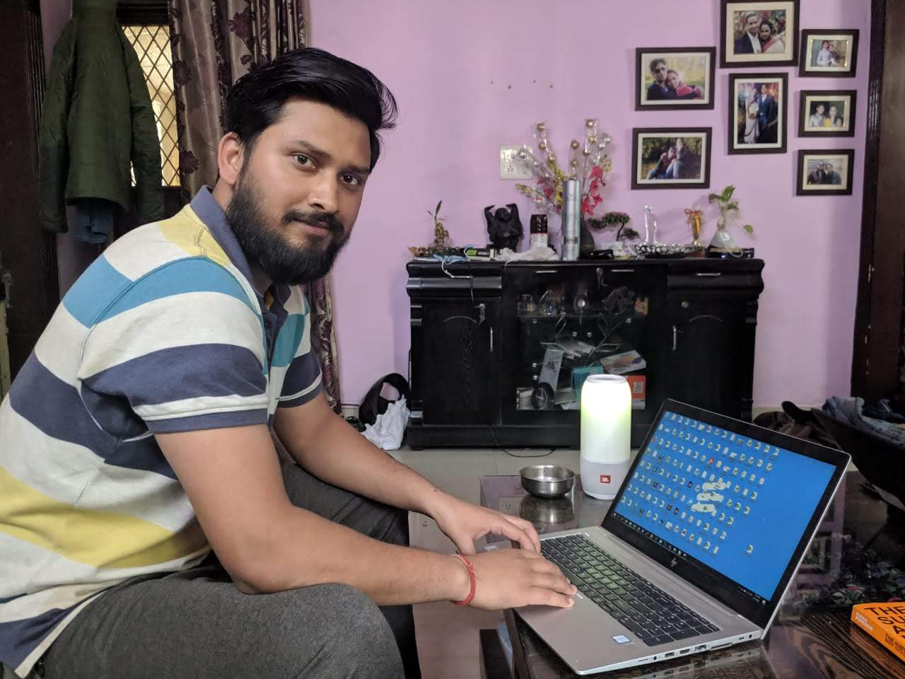
Then
Now

Slide 20
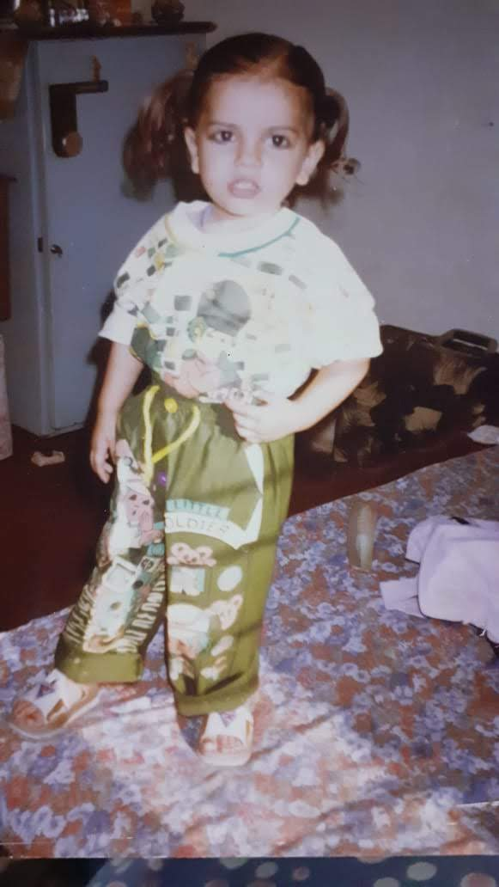
“We didn’t realize we were making memories we just knew we were having fun.”

Slide 21
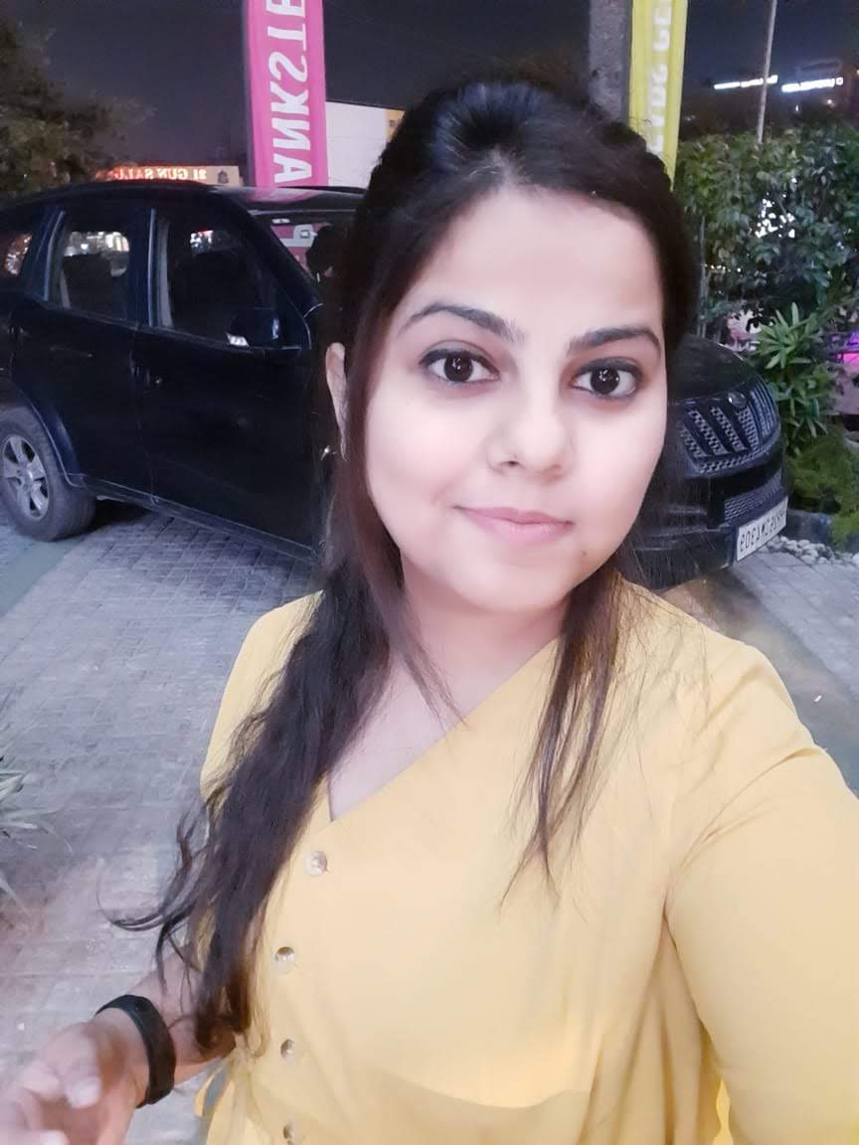
Then
Now

Slide 22
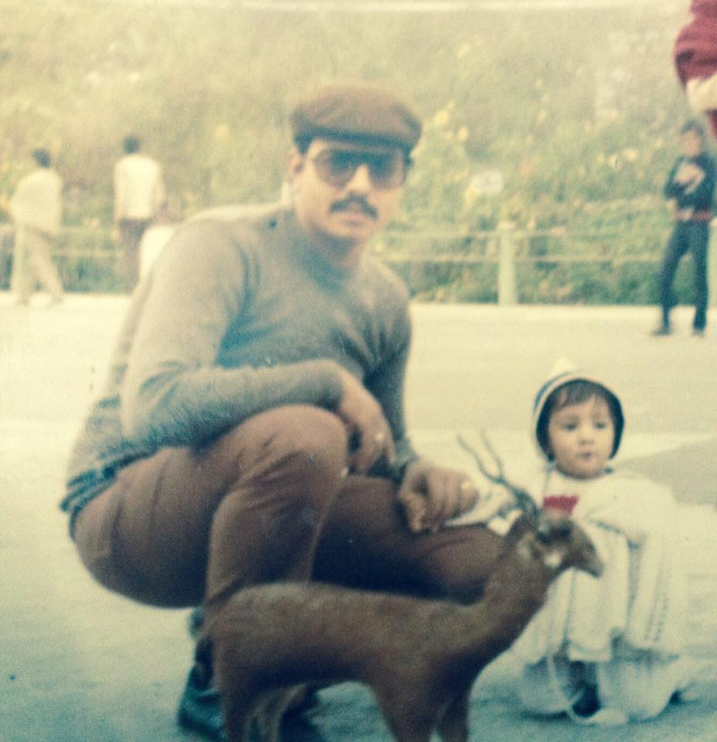
In each person, there is a child hidden deep inside his heart, waiting to be awakened again.

Slide 23
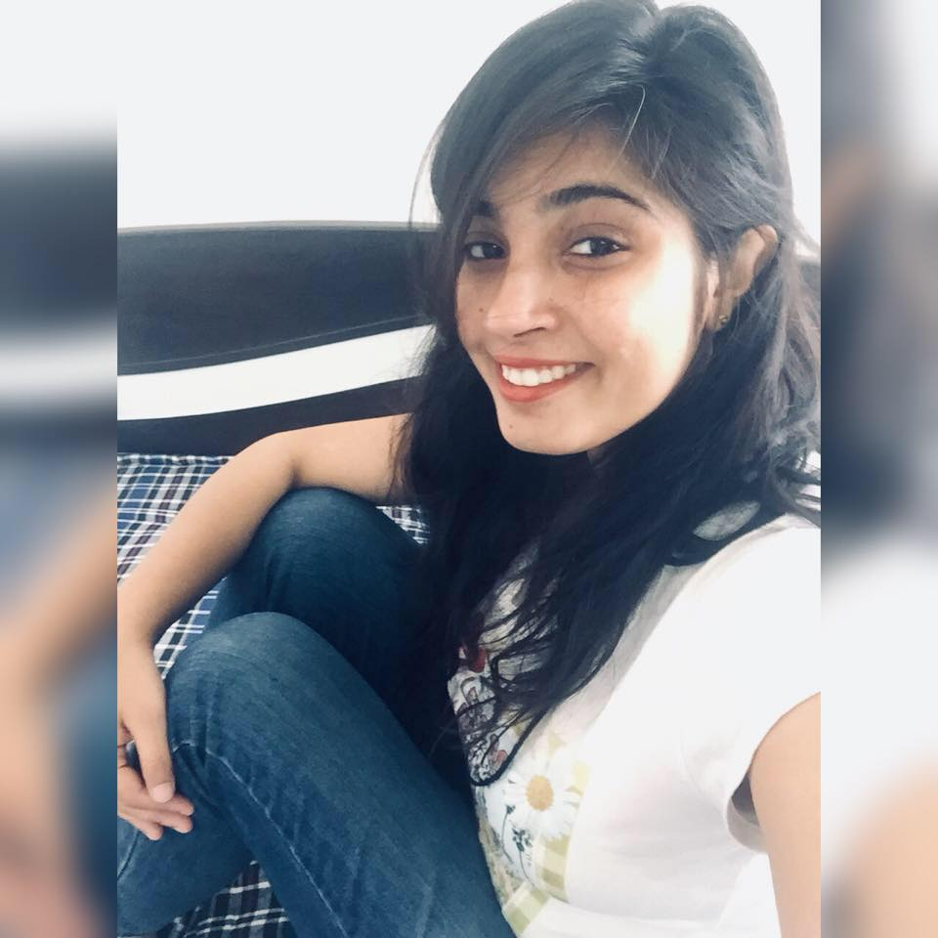
Then
Now

Slide 24
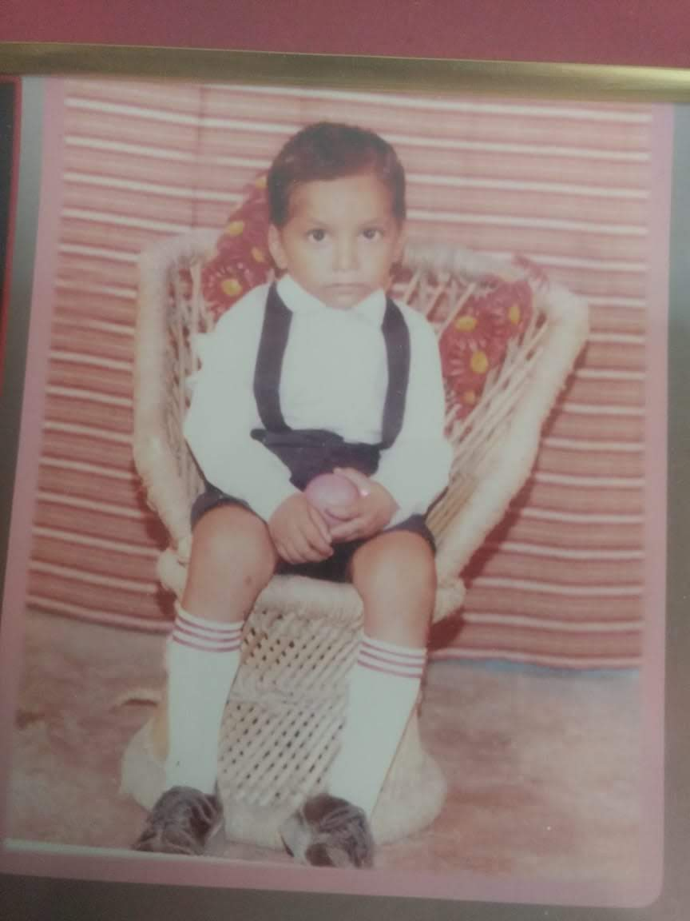
Childhood is like being drunk, everyone remembers what you did, except you.

Slide 25
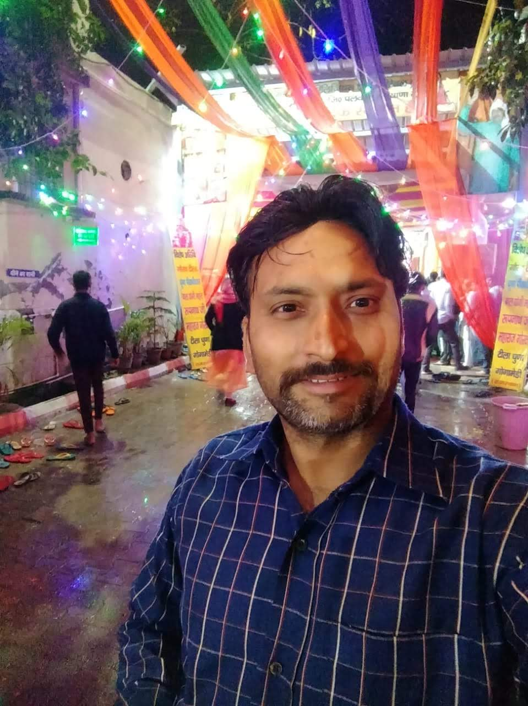
Then
Now

Slide 26
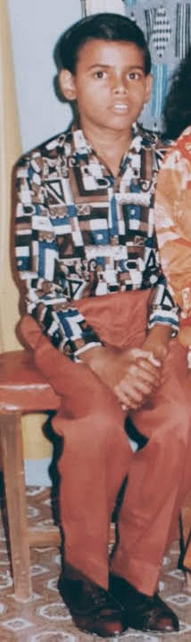
I spent my whole childhood wishing I were older and now I’m spending my adulthood wishing I were younger.

Slide 27

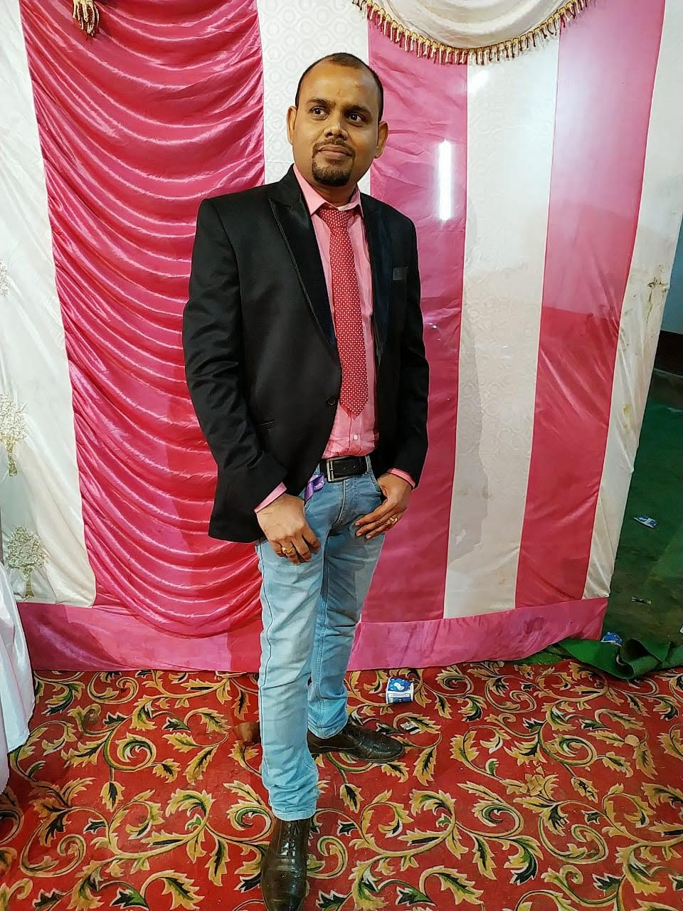
Then
Now

Slide 28
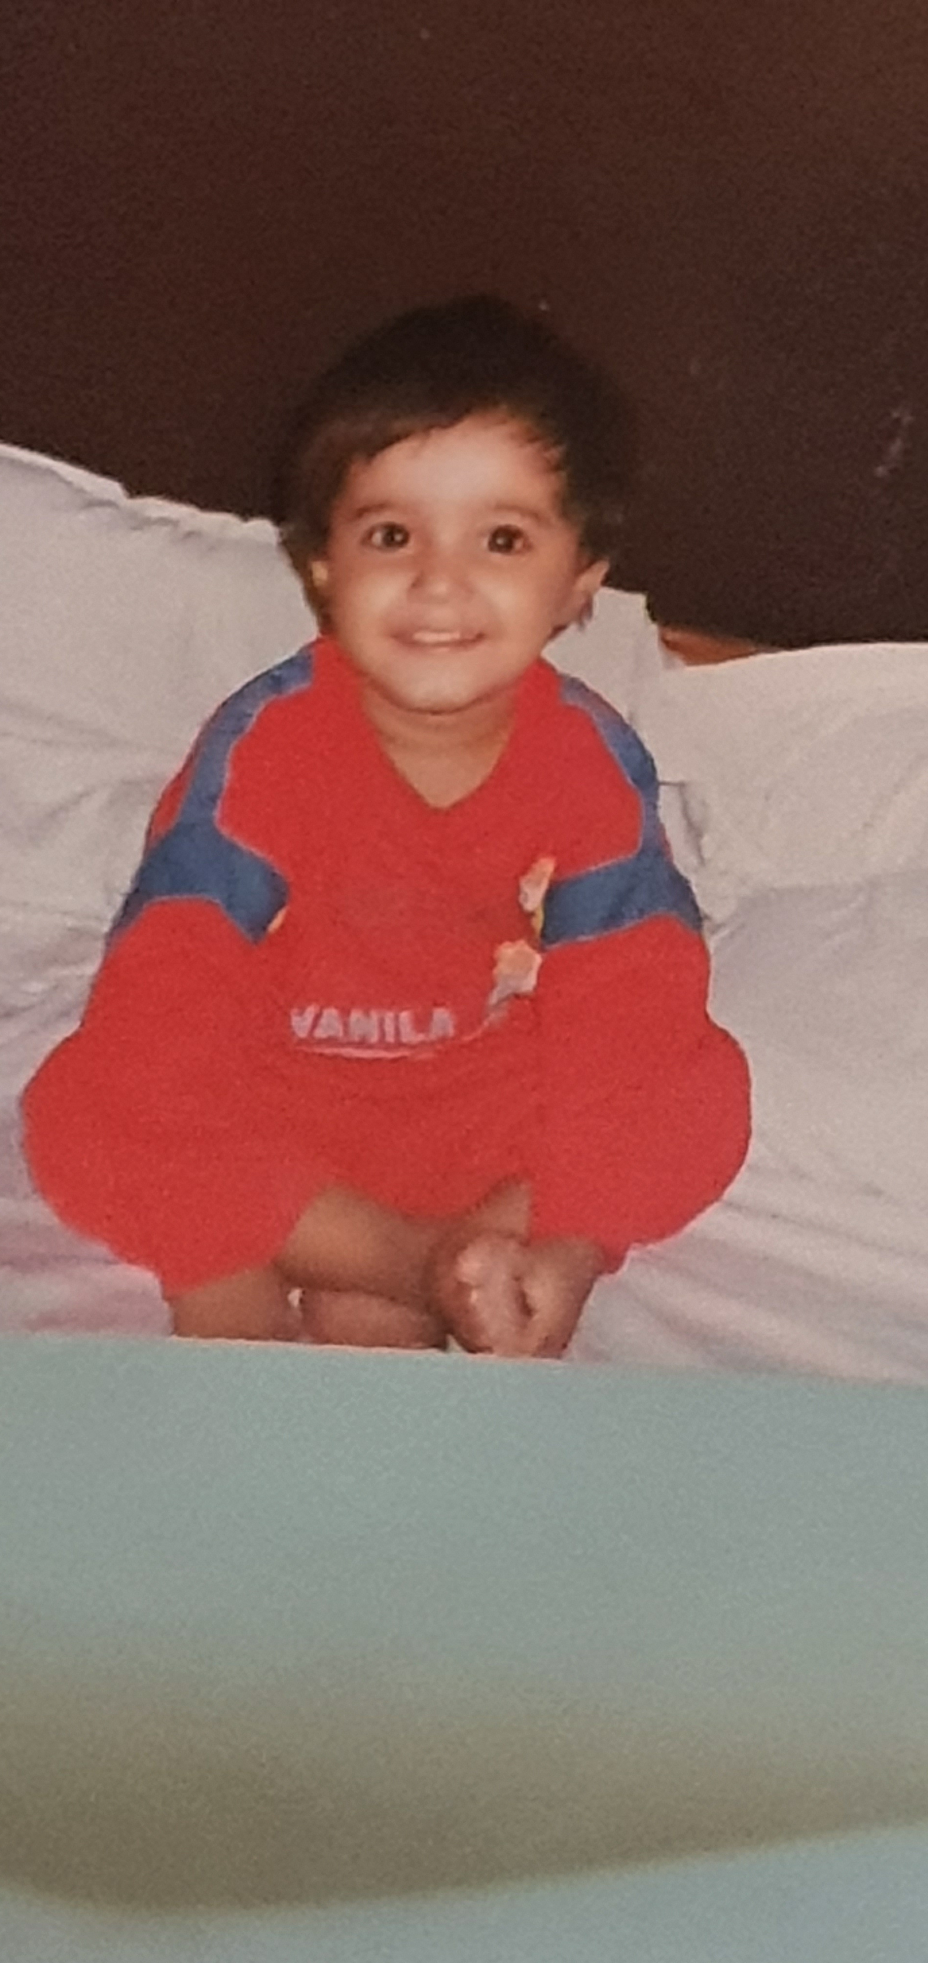
“Childhood means simplicity. Look at the world with the child’s eye – it is very beautiful.”

Slide 29
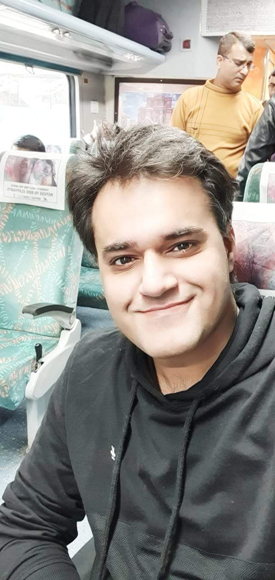
Then
Now

Slide 30
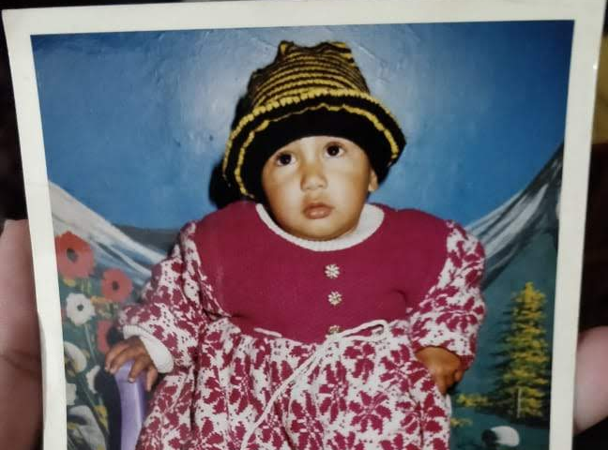

Slide 31
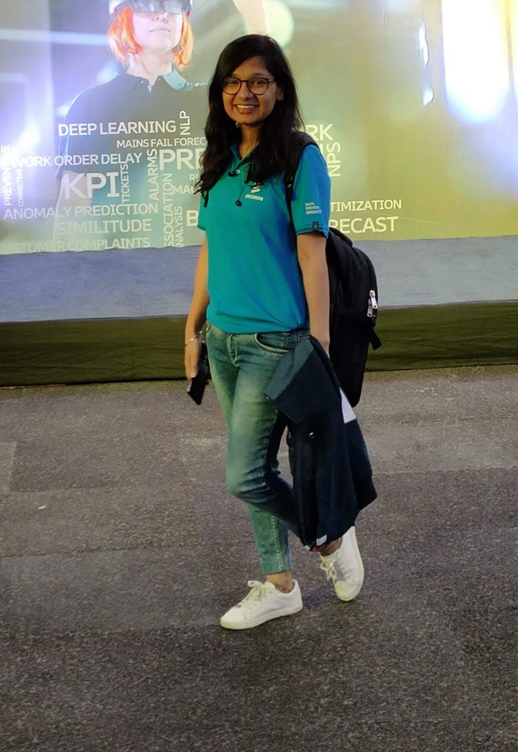
Then
Now

Slide 32
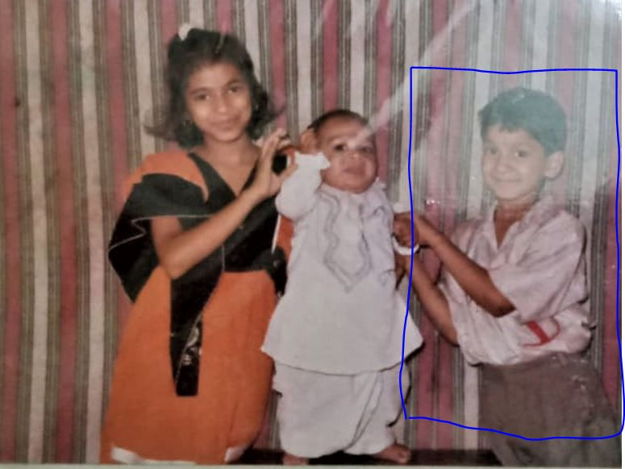

Slide 33
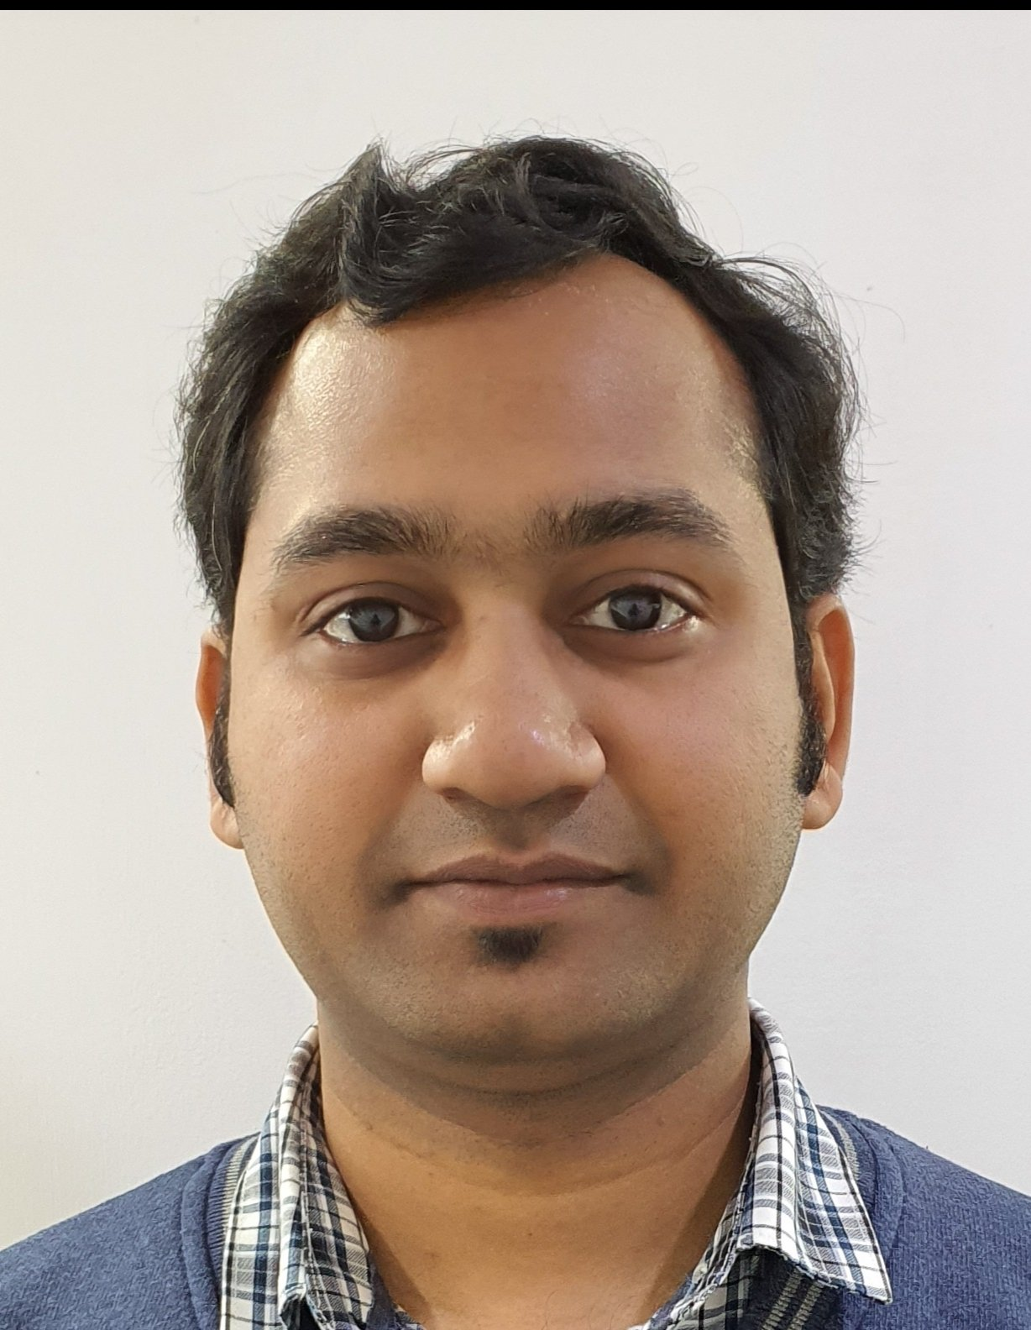
Then
Now

Slide 34
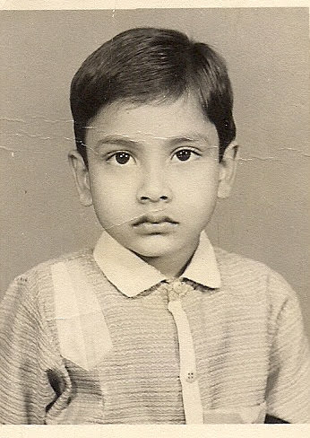
Listening to the Beatles’ music figures into pretty much all of my childhood memories.

Slide 35
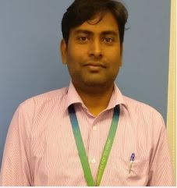
Then
Now

Slide 36
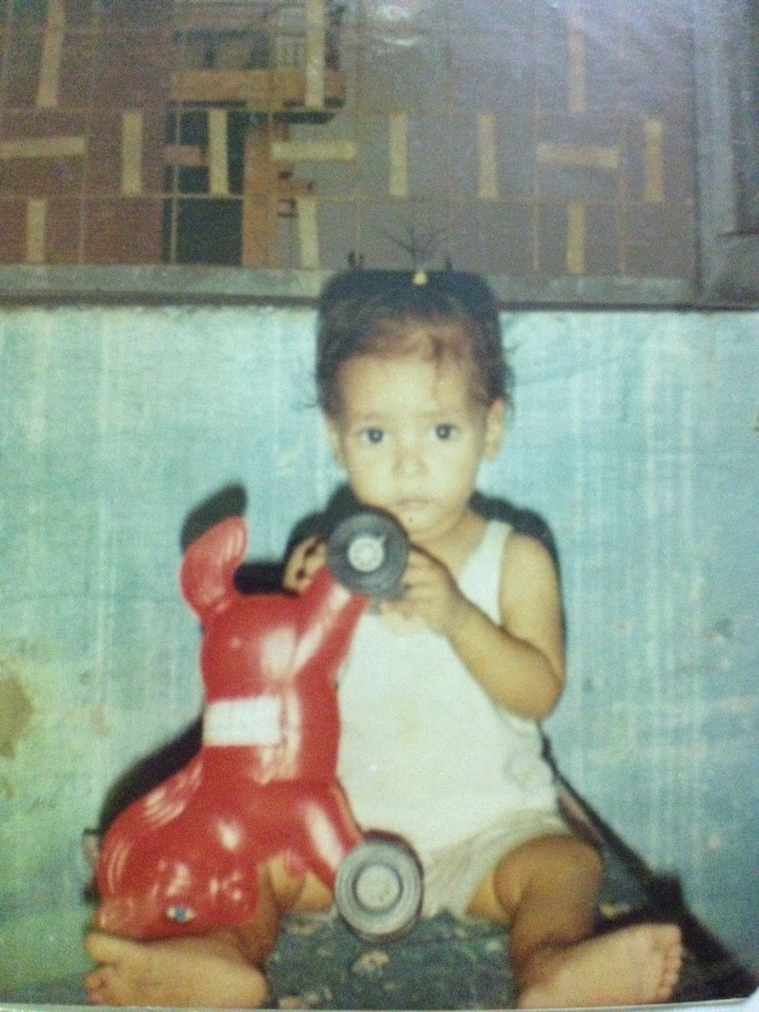
“Don't you wish you could take a single childhood memory and blow it up into a bubble and live inside it forever?”

Slide 37
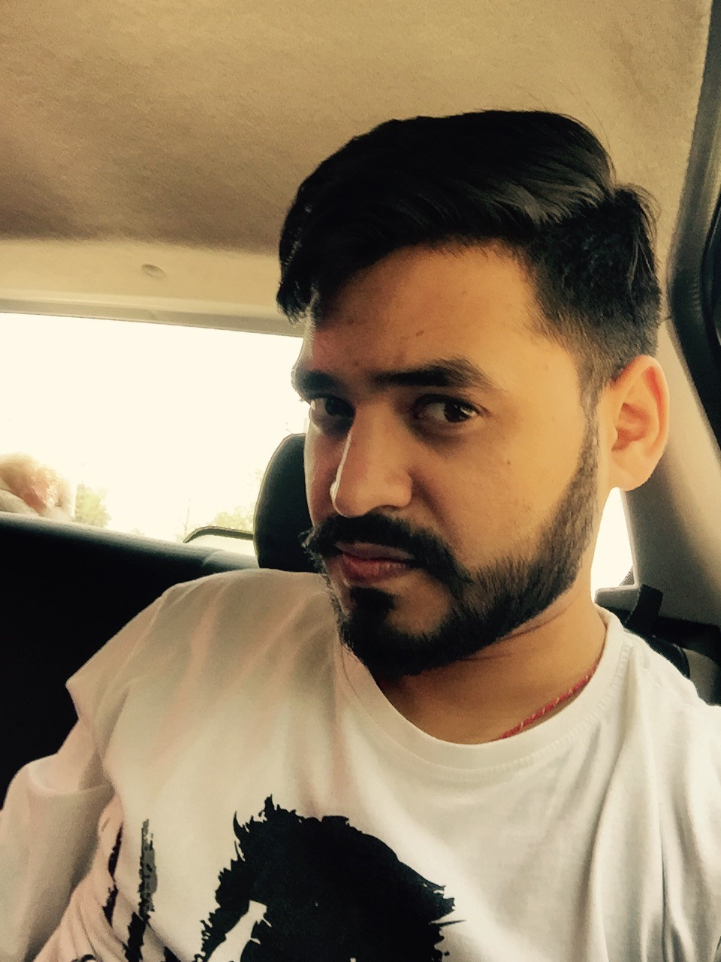
Then
Now

Slide 38
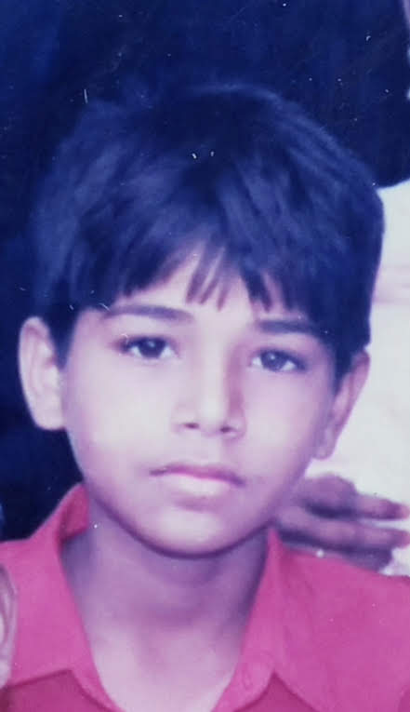
If you carry your childhood with you, you never become older.
If you carry your childhood with you, you never become older.

Slide 39

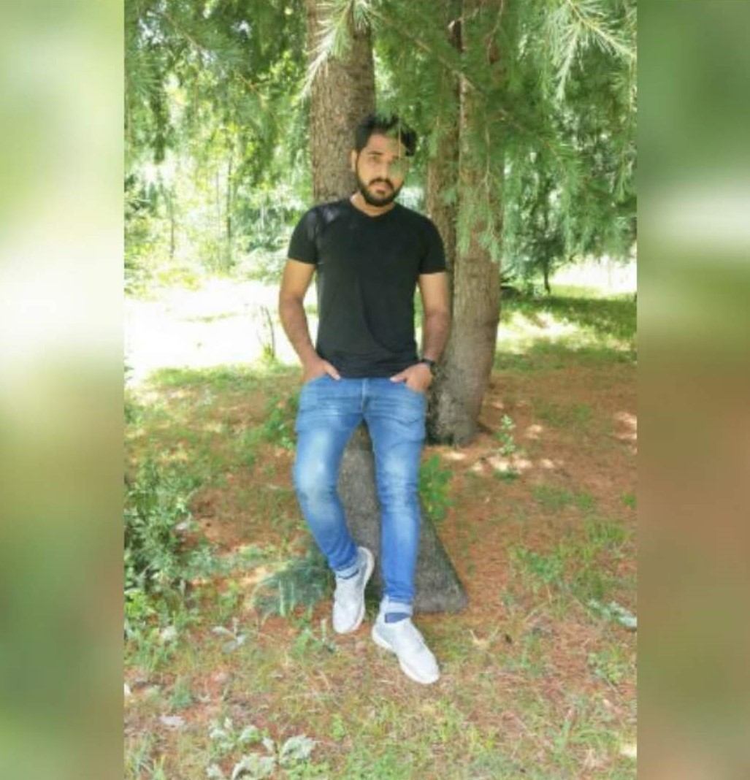
Then
Now

Slide 40
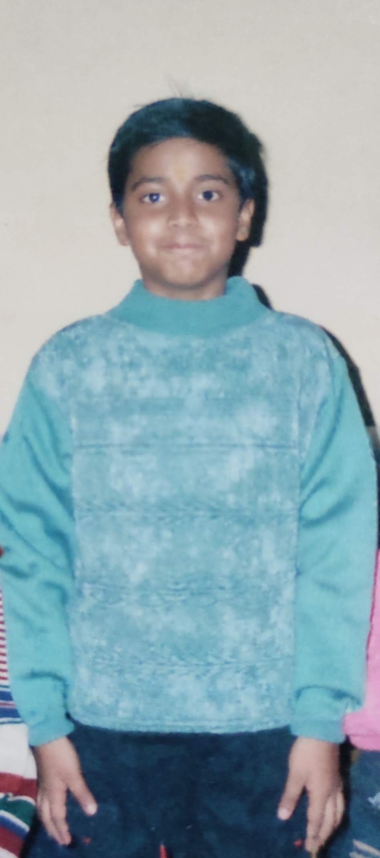
I’m thankful my childhood was filled with bruises from playing outside, instead of apps and how many likes you get on a picture.

Slide 41
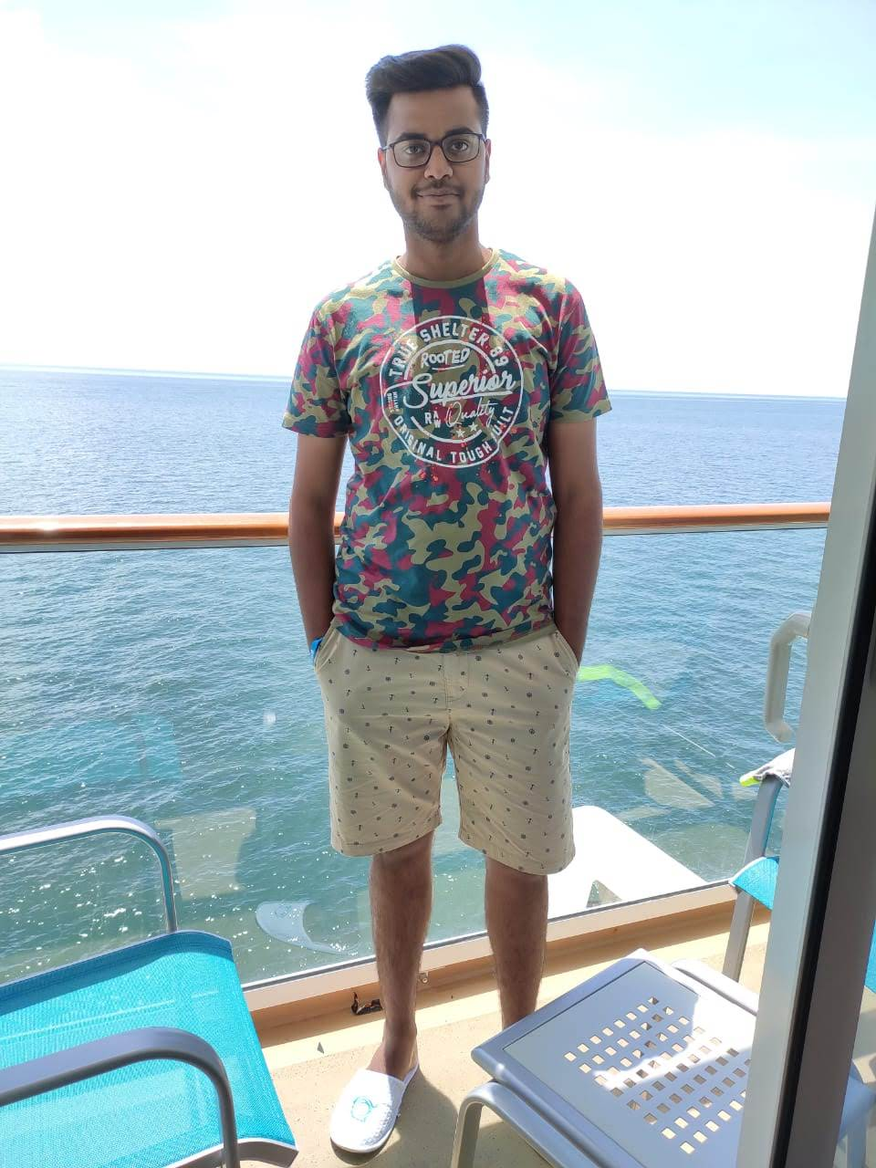
Then
Now

Slide 42
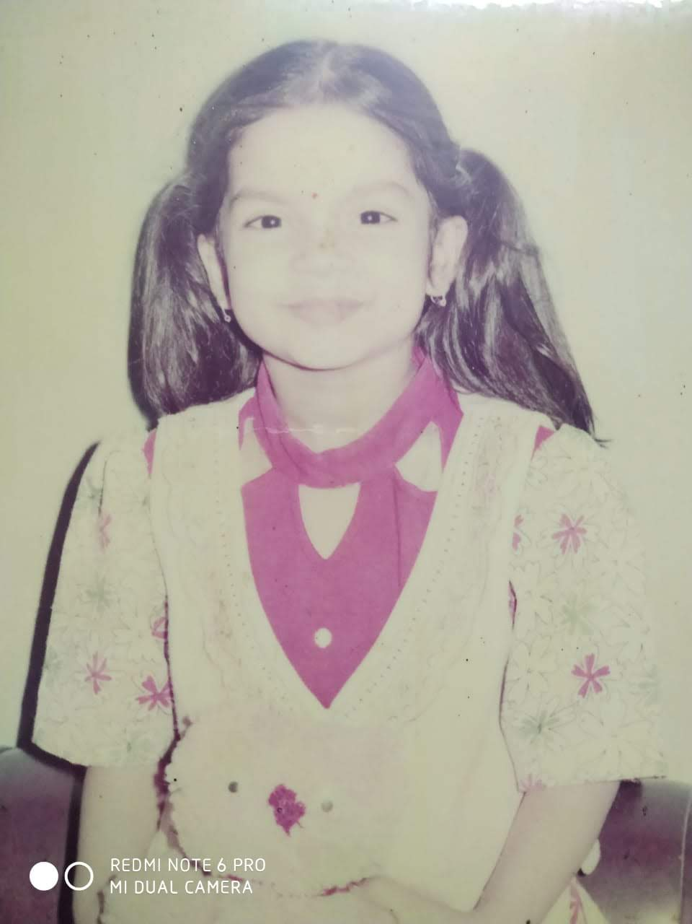
Childhood is the light of our life, we must keep it safe within our hearts.

Slide 43

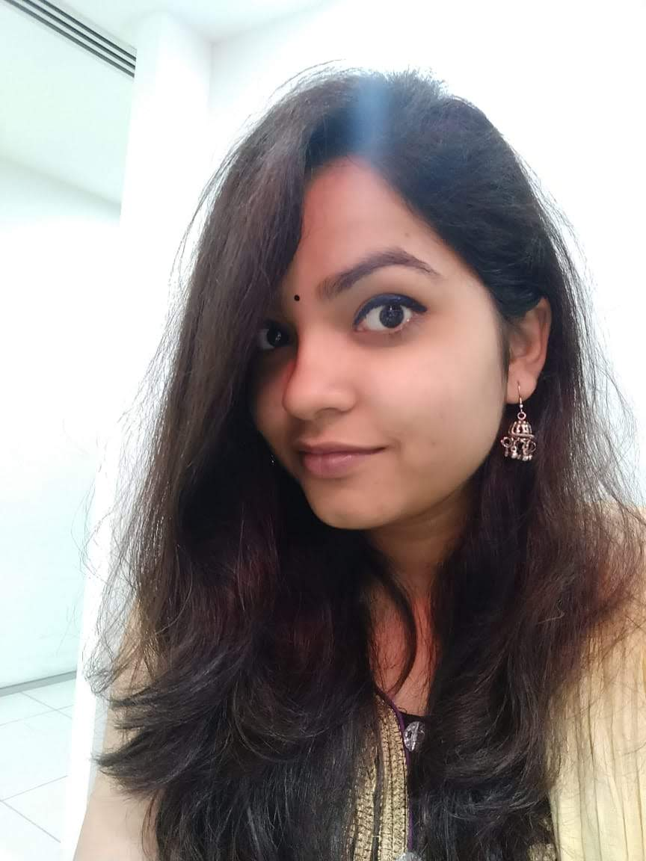
Then
Now

Slide 44
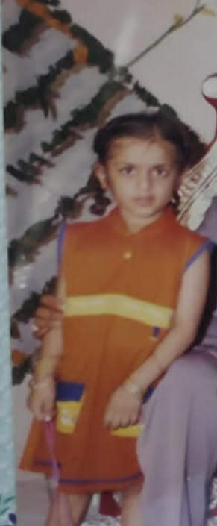

Slide 45
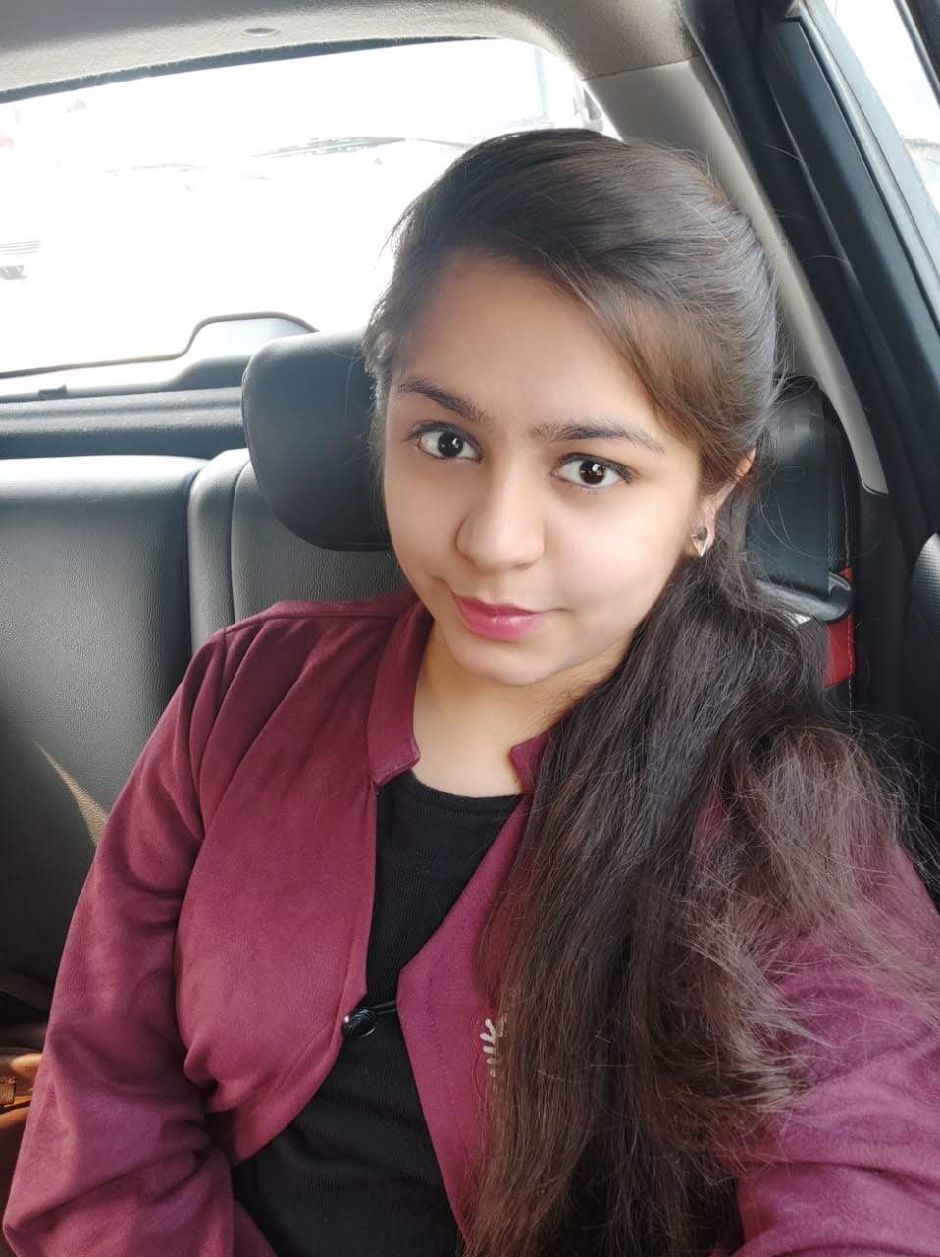
Then
Now

Slide 46
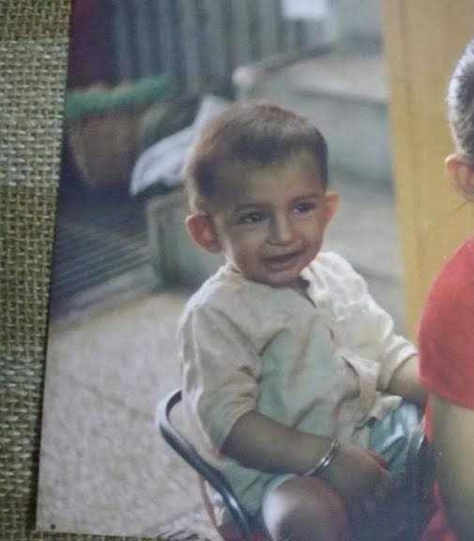
Twinkle Twinkle Little Star…How I wonder what you are

Slide 47
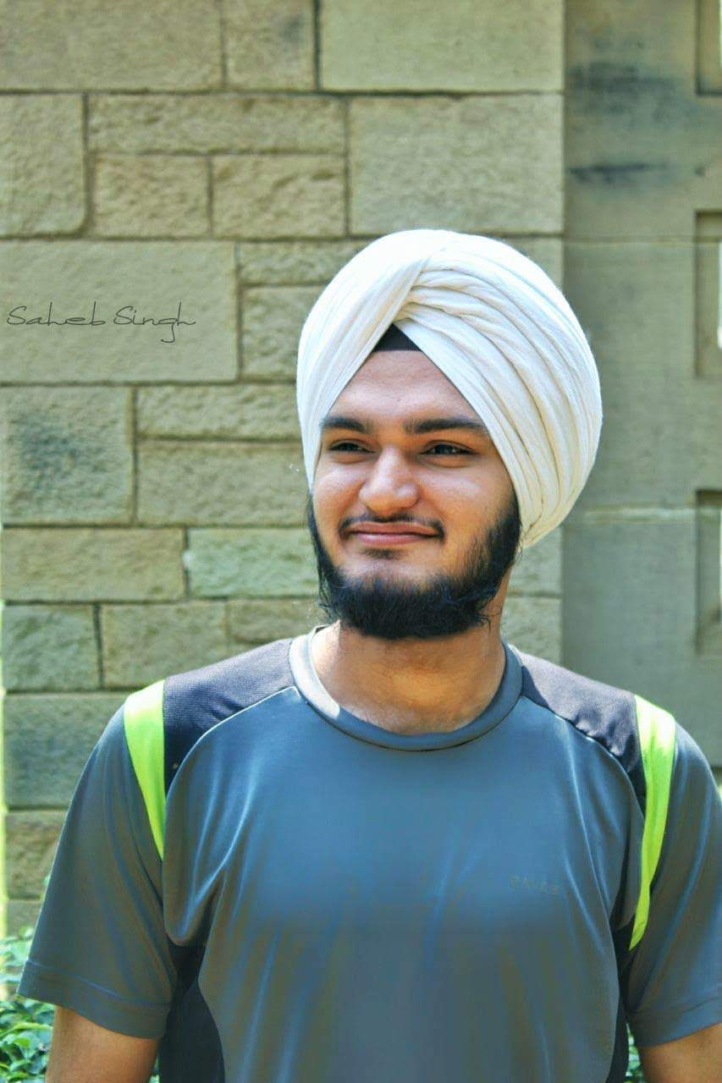
Then
Now

Slide 48
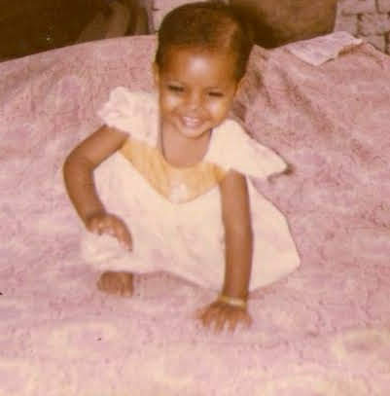

Slide 49
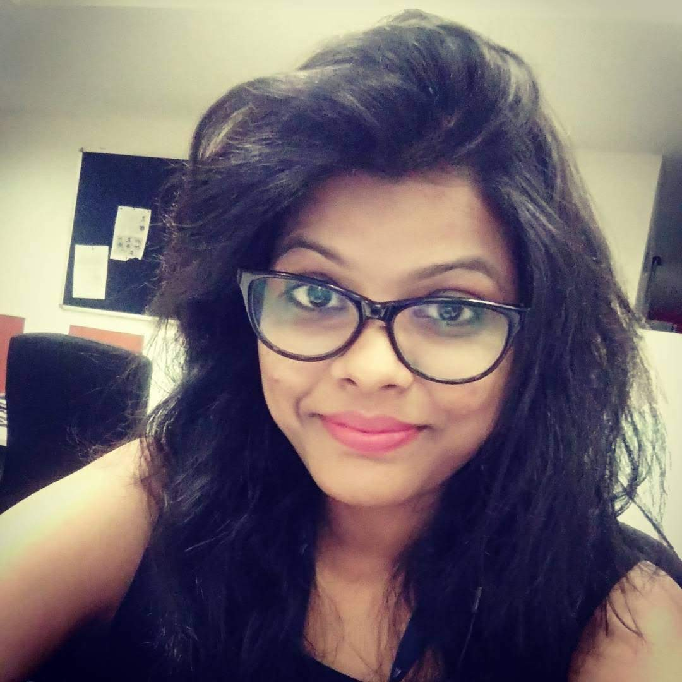
Then
Now

Slide 50
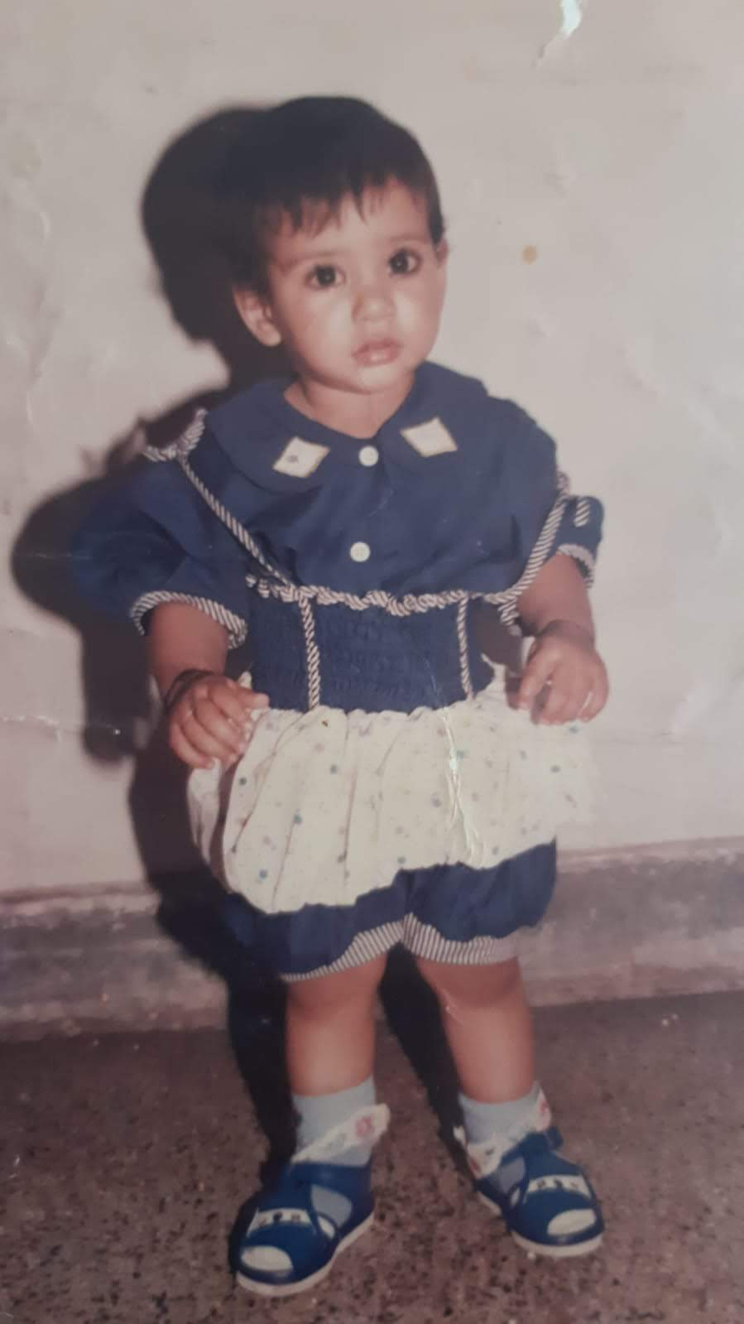

Slide 51
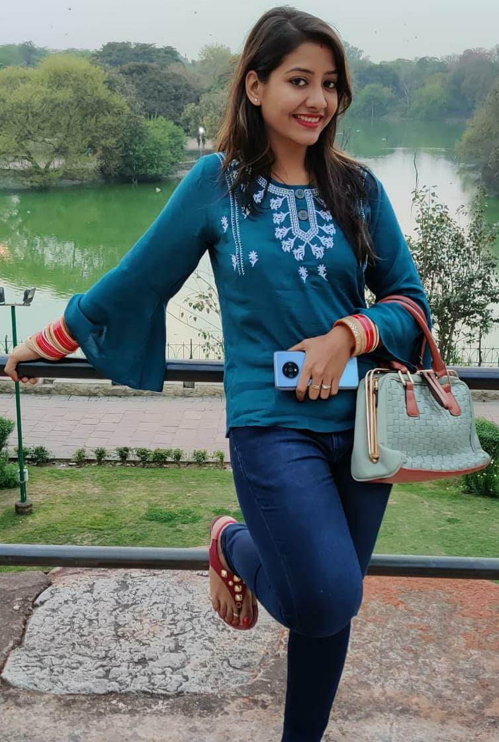
Then
Now

Slide 52
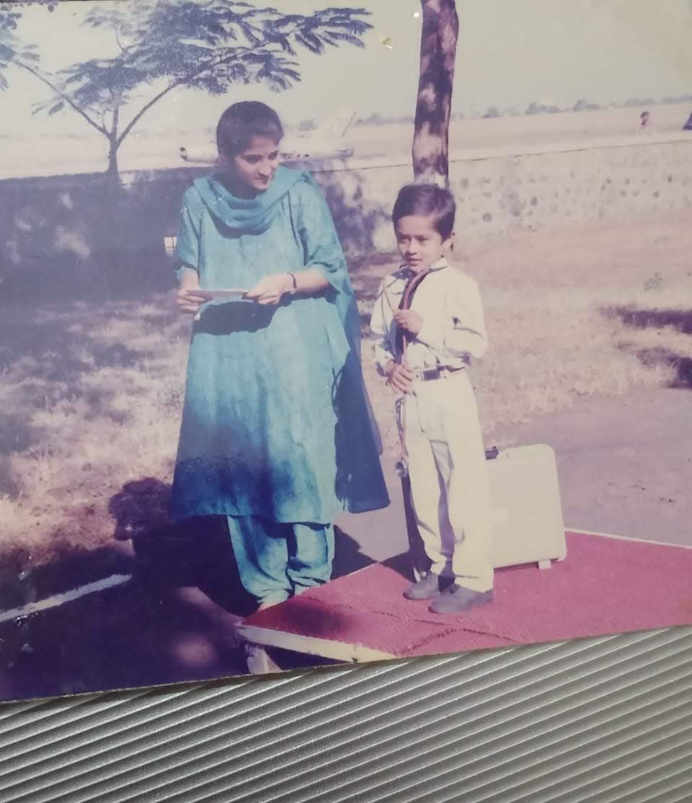

Slide 53

Then
Now

Slide 54


Slide 55

Then
Now

Slide 56

“Being a kid was much more fun than being an adult. Life was sweeter then.”

Slide 57

Then
Now

Slide 58


Slide 59

Then
Now

Slide 60


Slide 61

Then
Now

Slide 62


Slide 63

Then
Now

Slide 64


Slide 65

Then
Now

Slide 66


Slide 67

Then
Now

Slide 68


Slide 69

Then
Now

